Slide 1
Forecasting VIX using ARIMA GARCH - Jiaqi Jiang
Introduction and Summary
Project Flow
First Order Differencing
ARIMA
ARIMA - GARCH
Conclusion

Slide 2
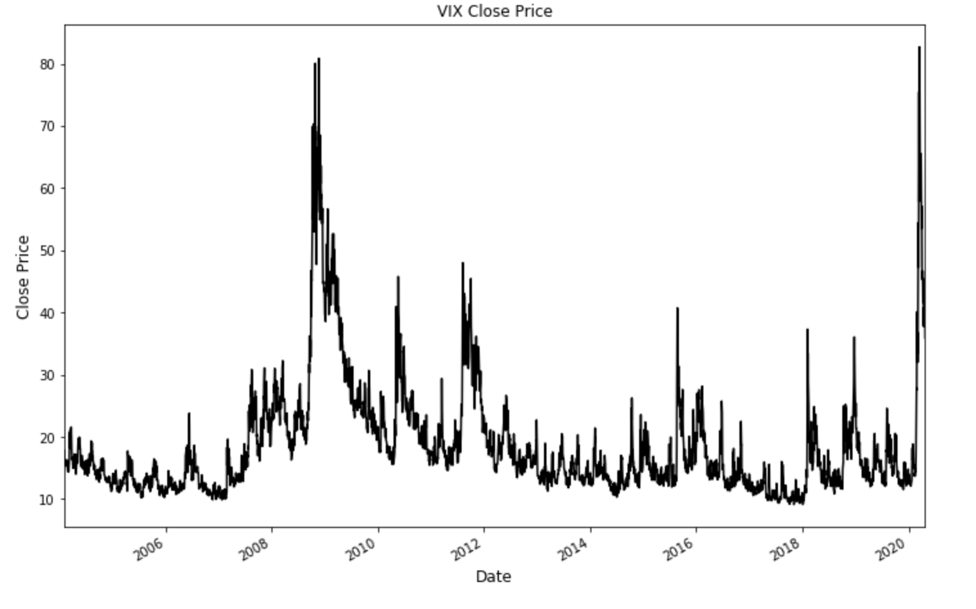
Data has trend
First order differencing to clear out trend, proceed with d=1
Auto ARIMA from python to find best model to be ARIMA(1,1,2)
Forecast using the model shows trend is explained but volatility is not modeled
Compare ARIMA - GARCH (2,1,2)-(1,1) to ARIMA - GARCH (1,1,2)-(1,1) and find ARIMA (1,1,2)-(1,1) is a better model
Use R Rugarch to find best model to be ARIMA - GARCH (2,1,2)-(1,1).
Project Flow

Slide 3
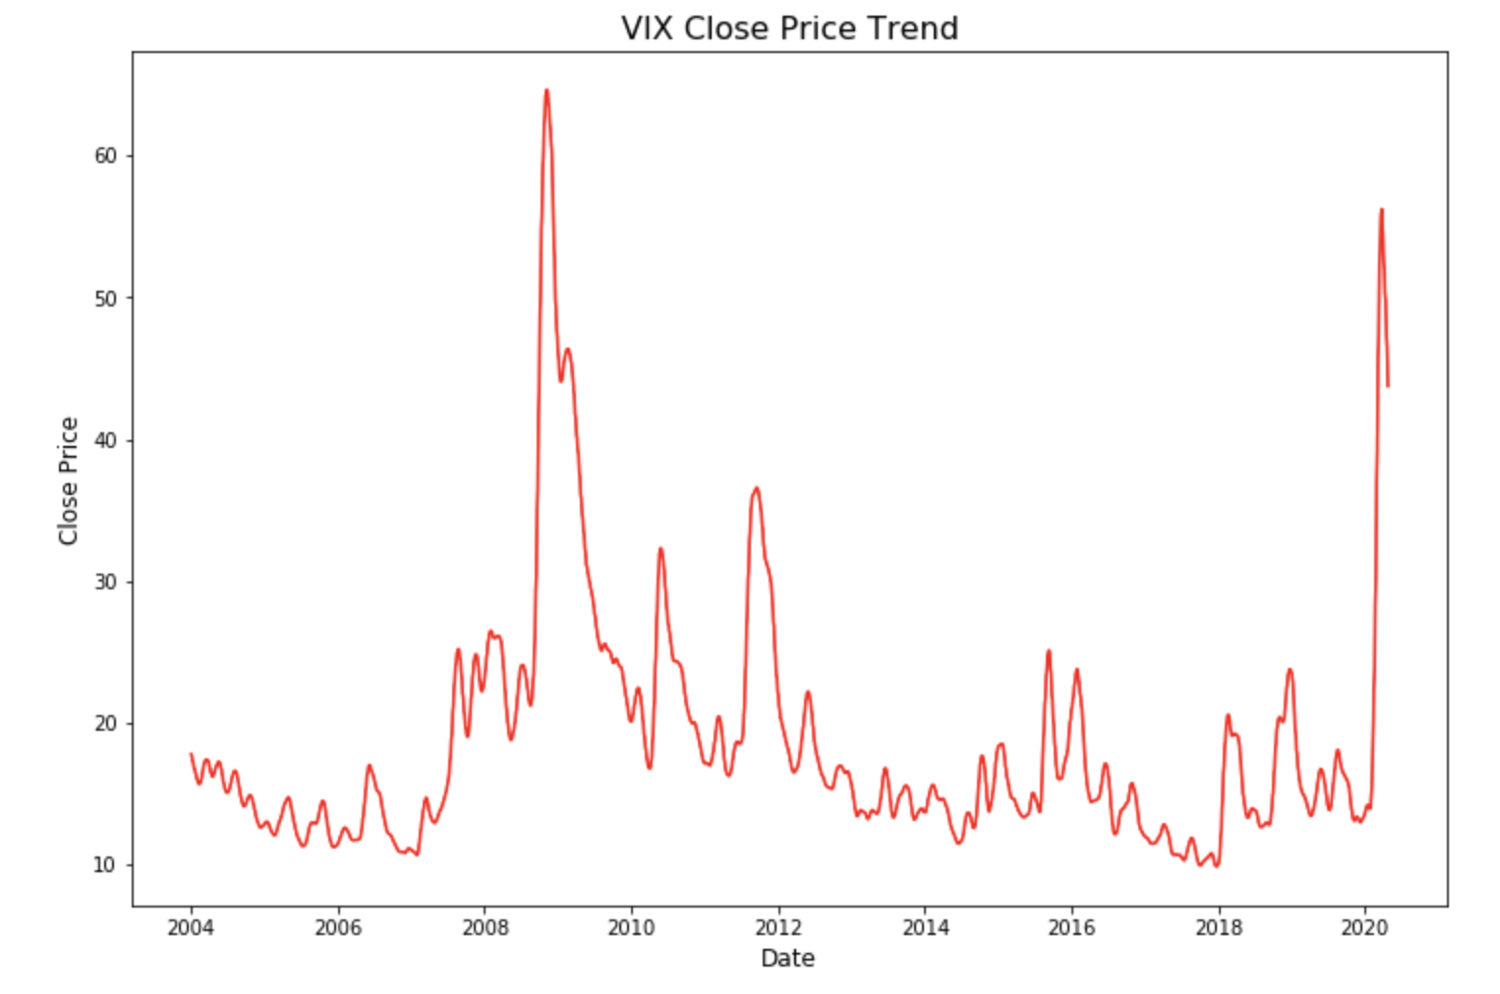
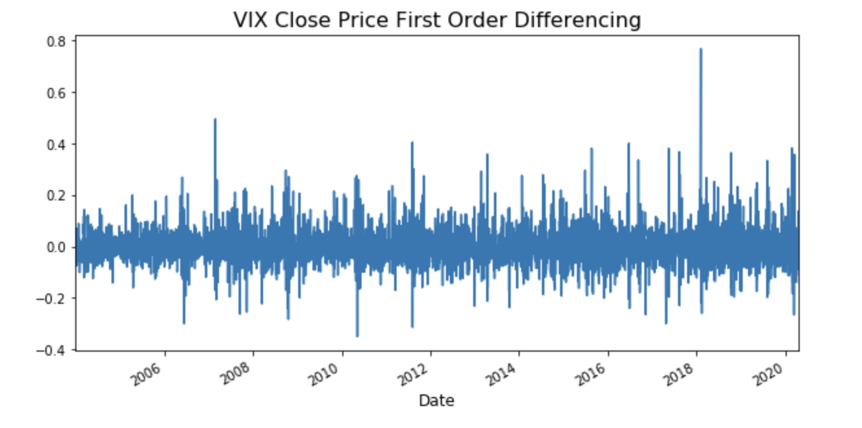
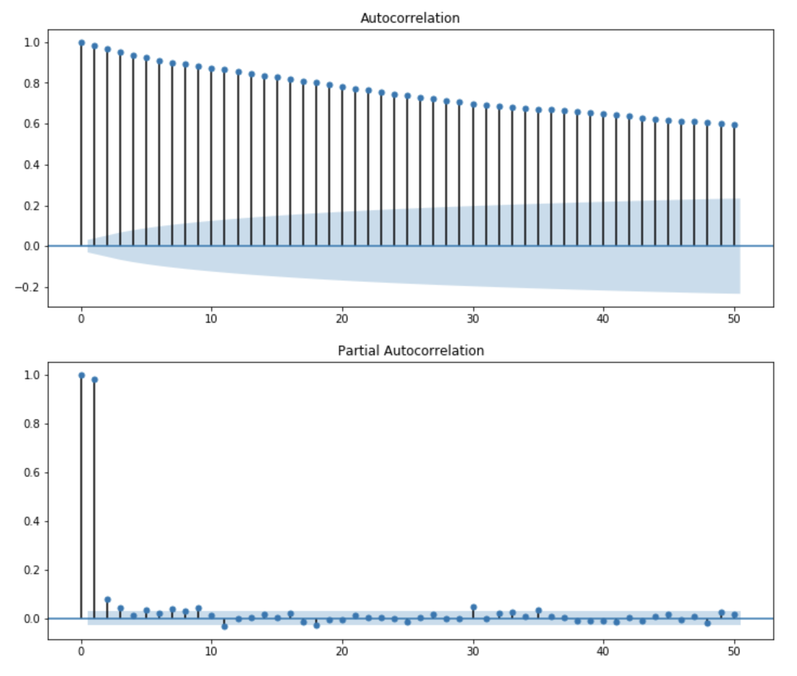
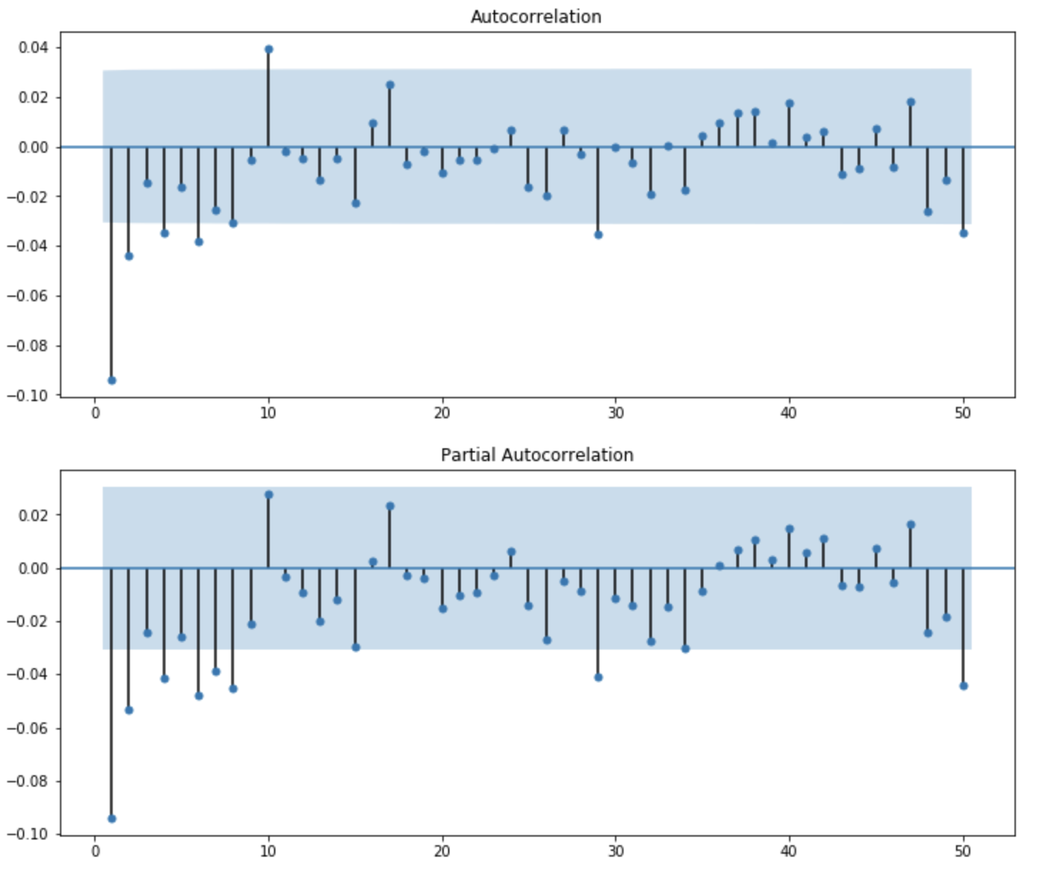
First Order Differencing
ACF PACF on log price vs ACF PACF of the first difference of log price (log return)

Slide 4
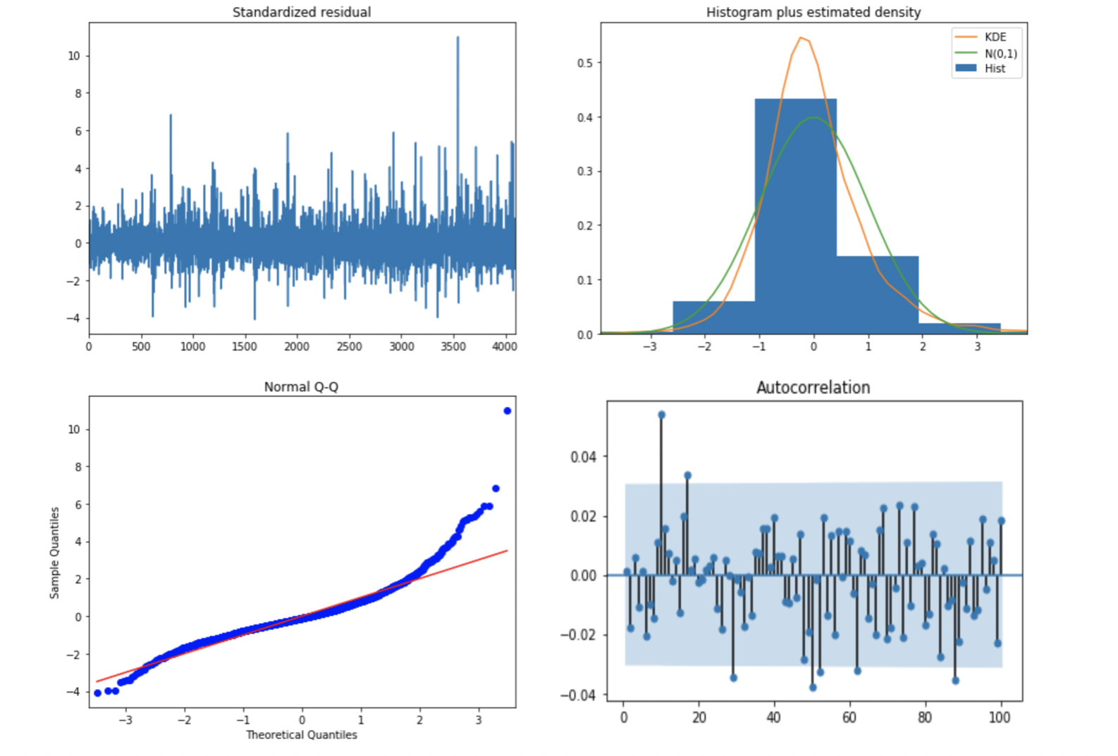
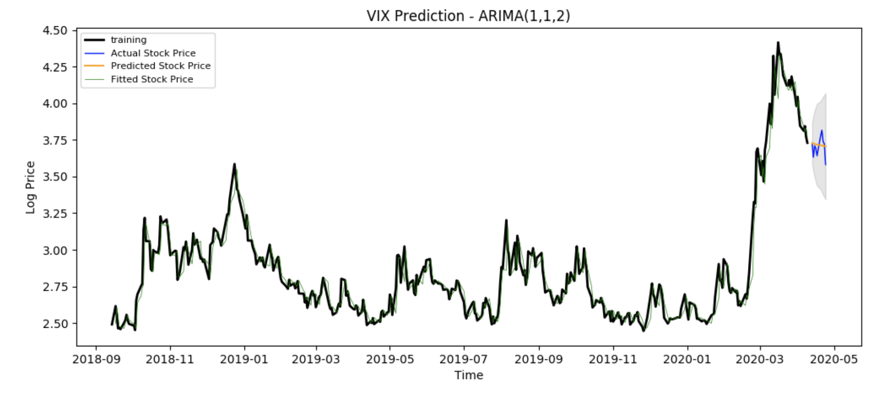
ARIMA (1,1,2) Model and Diagnostic

Slide 5
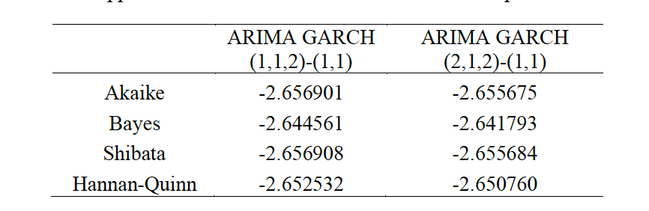
GARCH Model Comparison

Slide 6
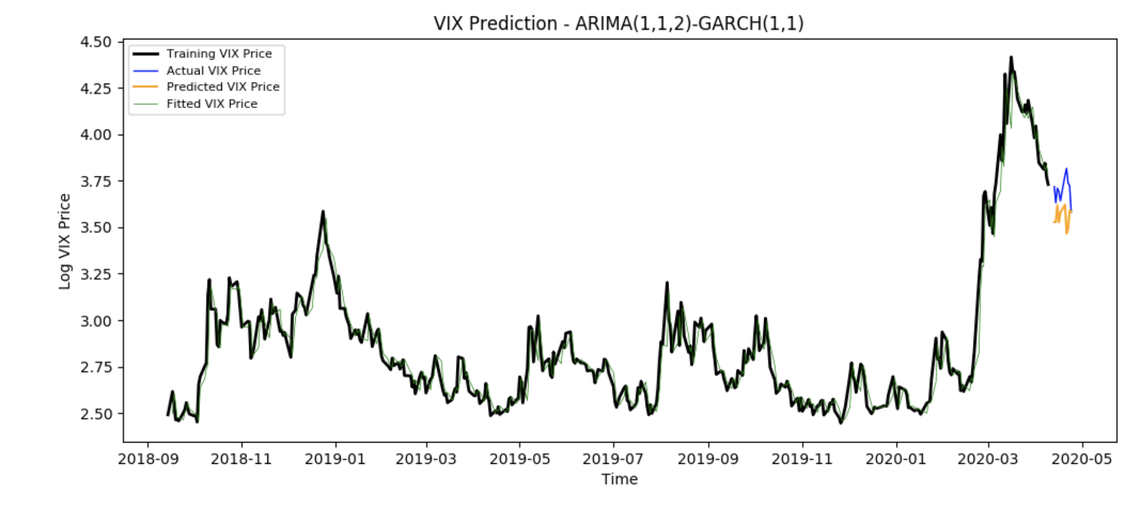
ARIMA (1,1,2) - GARCH (1,1)

Slide 7
Conclusion
ARIMA GARCH has a better forecast power. But neither can predict extreme events such as Covid-19 which change the trend so dramatically.
ARIMA tends to flat out very fast without seasonal factor, seasonal factor has not shown in financial assets such as VIX.
Python does not have package such as Rugarch which efficiently combined ARIMA and GARCH.
Further analysis should focus on bringing in exogenous factors.

